Slide 1
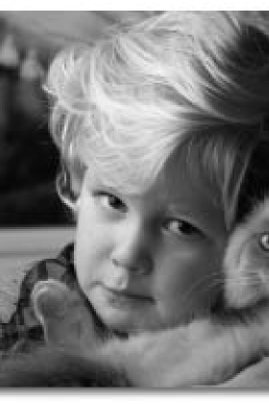
The Nexus Between Animal Abuse and Domestic Abuse
Presented by:
W. Patrick Swanton NICP

Slide 2
Training Objectives
Define animal abuse.
List the forms of animal abuse.
List the common characteristics of animal abuse & human victimization.
List the reasons why people are cruel to animals.

Slide 3
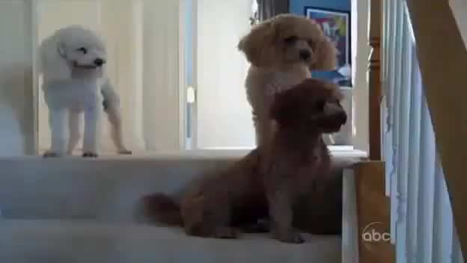

Slide 4
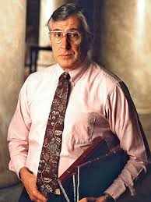
The Relationship Between Animal Abuse & Domestic Abuse
Robert K. Resler
1937-2013
"Murderers…
very often start
out by killing
and torturing
animals as kids."
FBI agent and author
Psychological profiler of violent offenders
Coined the term ‘serial killer’

Slide 5
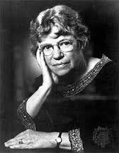
The Relationship Between Animal Abuse & Domestic Abuse
Margaret Mead Anthropologist
“One of the most dangerous things that can happen to a child is to kill or torture an animal… and get away with it”.

Slide 6
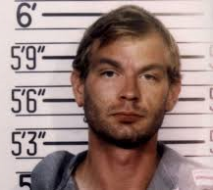
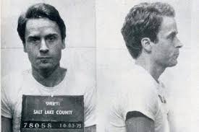
Notorious Killers
Jeffrey Dahmer
Impaled dogs’ heads, frogs and cats on sticks.
Ted Bundy
Claimed responsibility for 30 murders
Tortured animals as a teenager

Slide 7
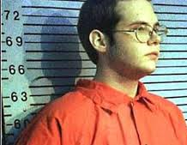
Notorious Killers
Luke Woodham - Pearl, Miss
Mortally stabbed his mother
Killed 2 classmates and shot 7 others
Bludgeoned his dog Sparkle with baseball bats
"I made my first kill today," he wrote in his journal. "It was a loved one...I'll never forget the howl she made. It sounded almost human."

Slide 8
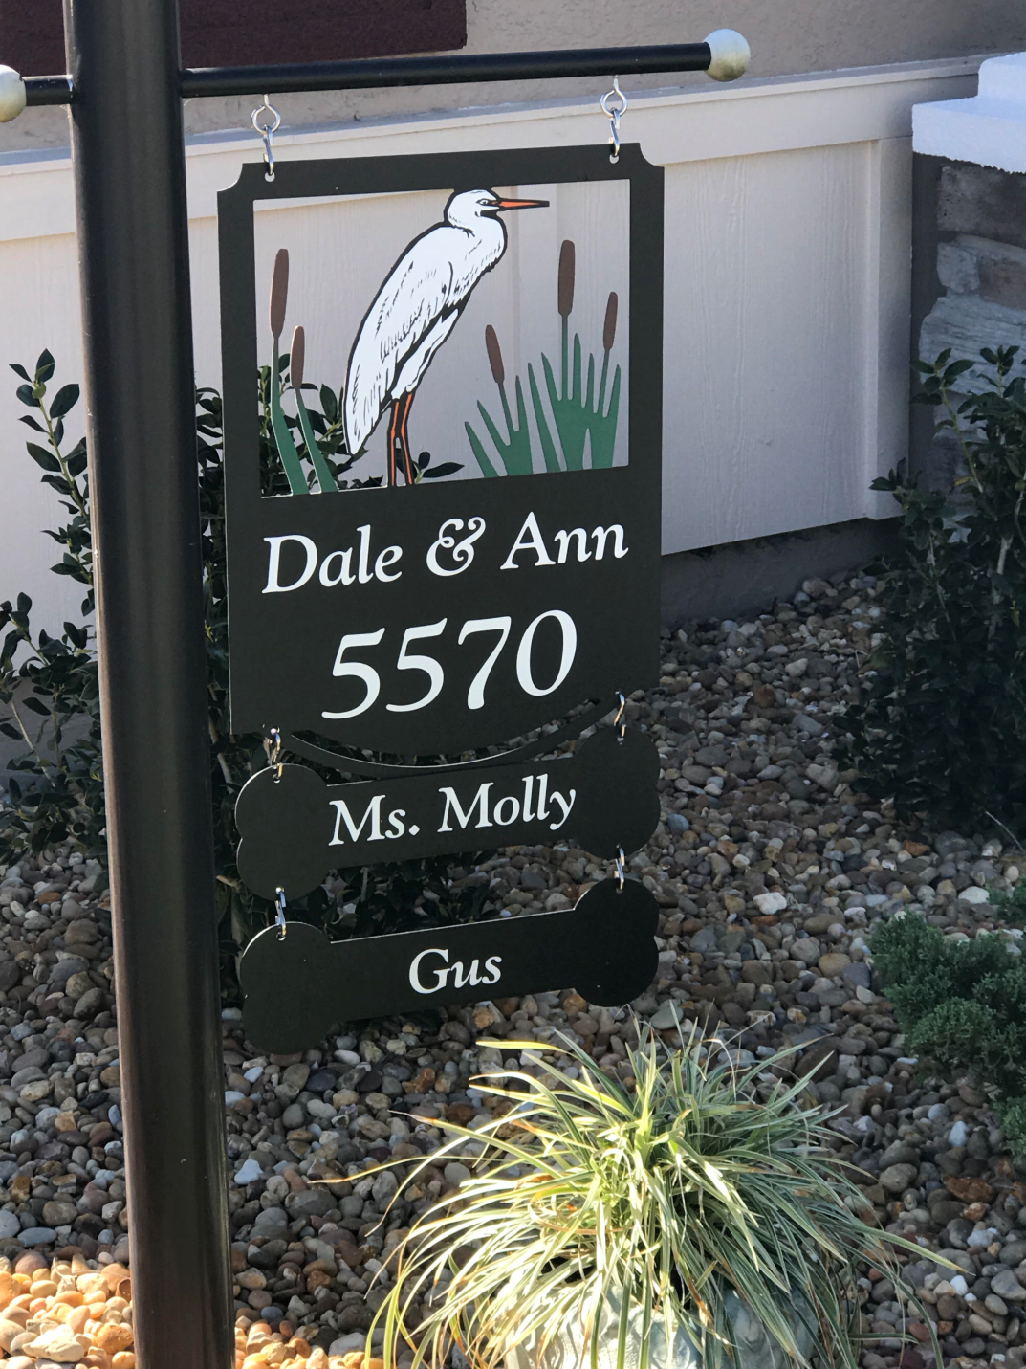
Who has a picture of their pet in their phone along with the pictures of family members?

Slide 9
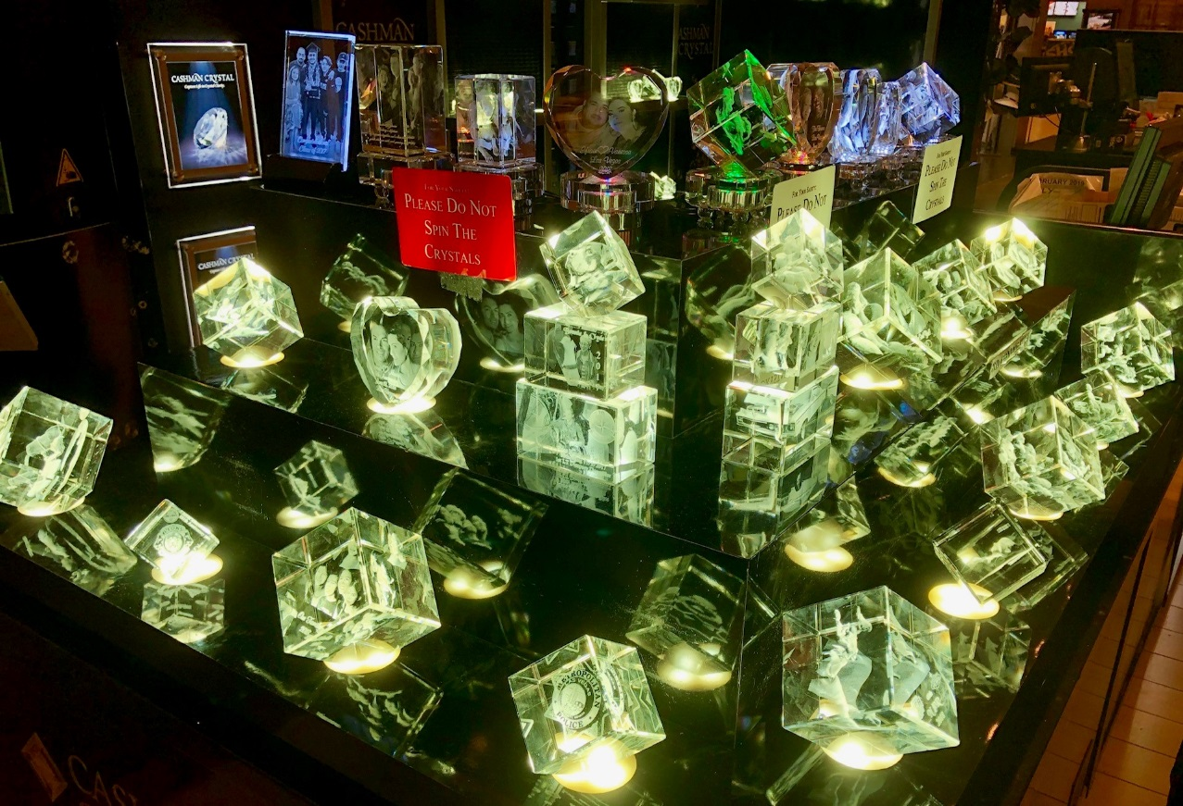
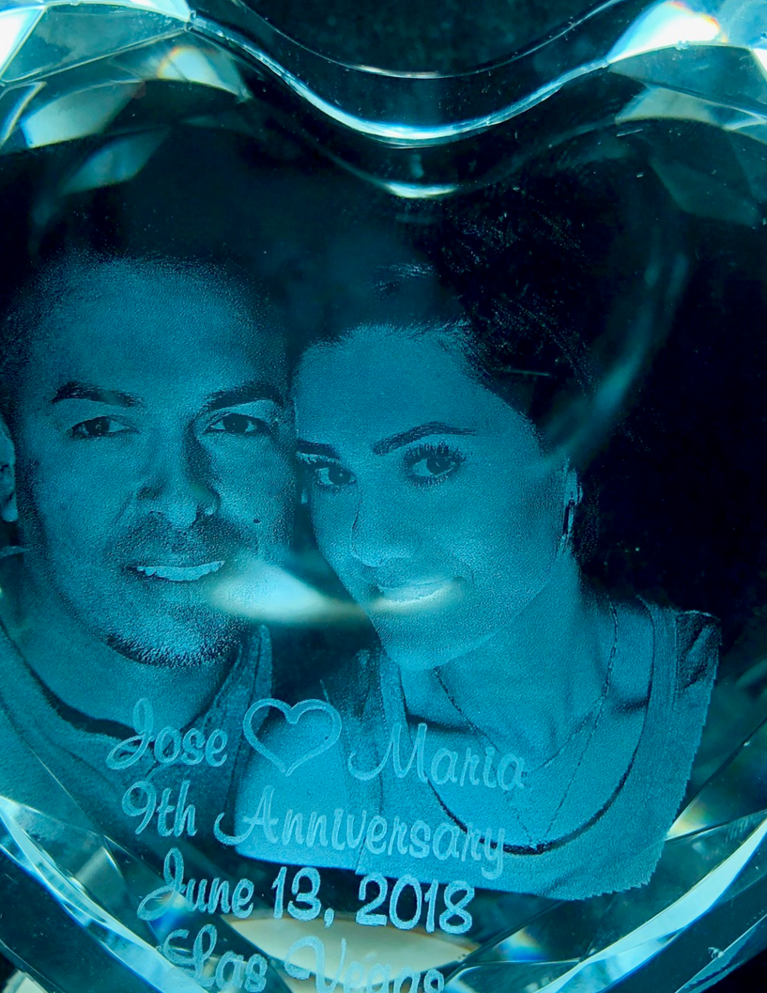
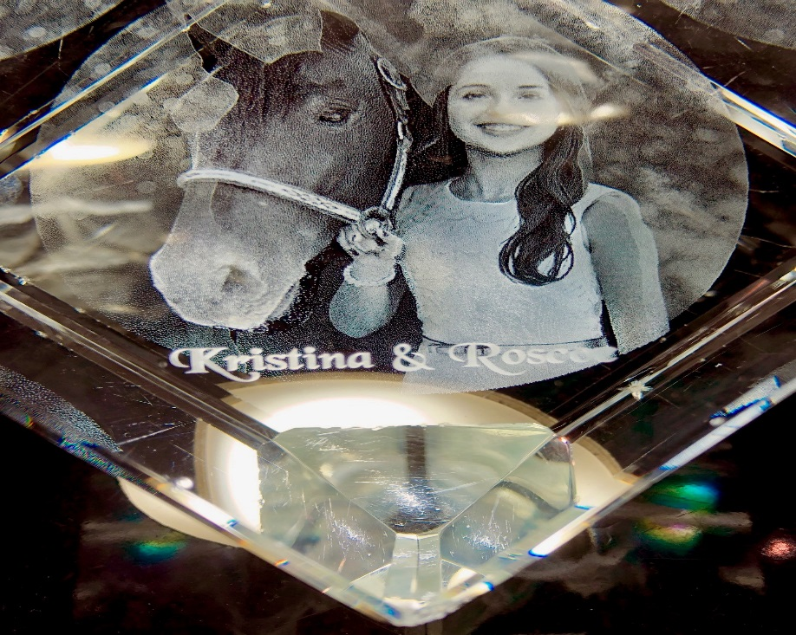
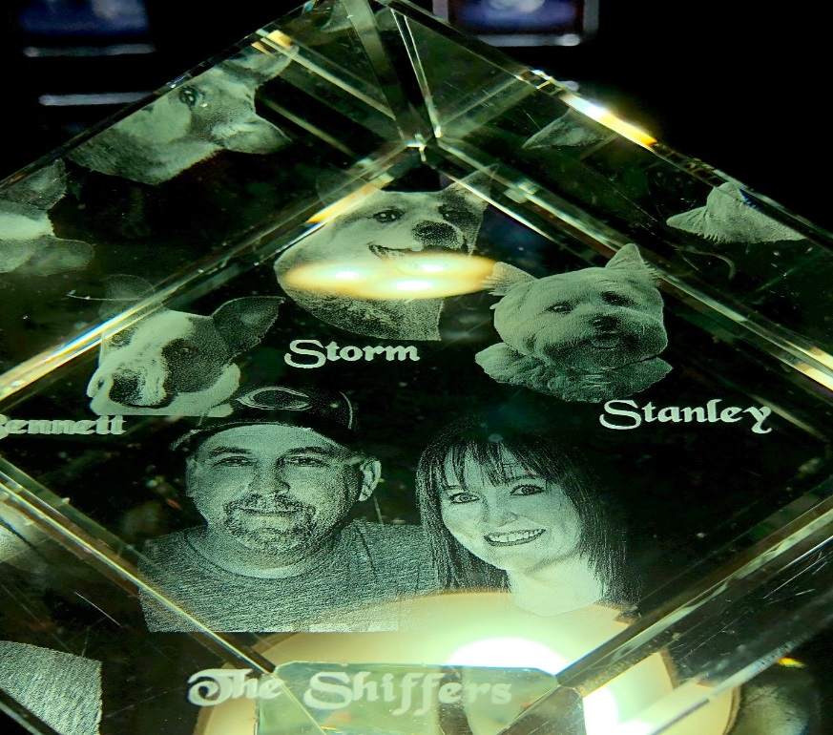

Slide 10
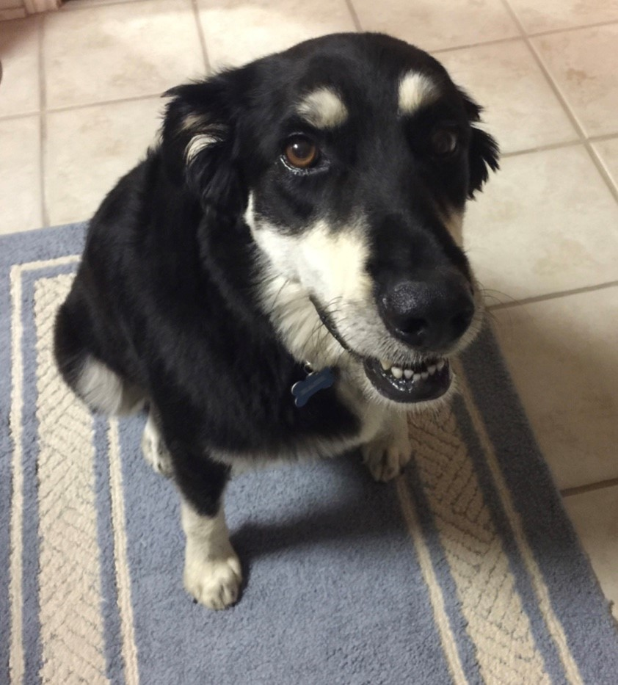
Grand-Dog Major

Slide 11
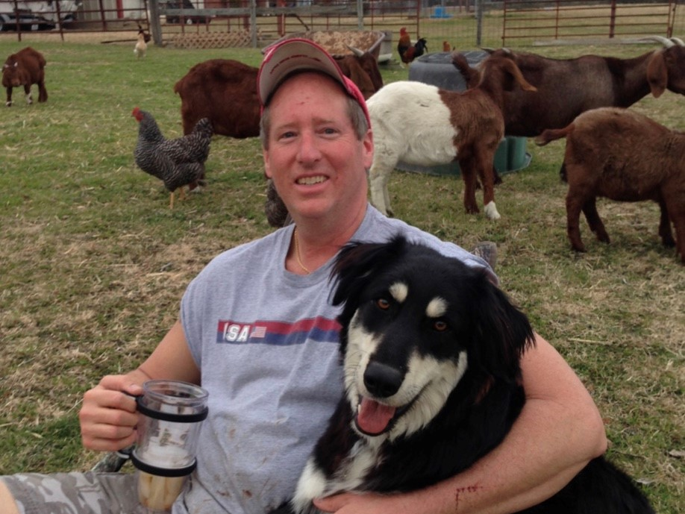

Slide 12
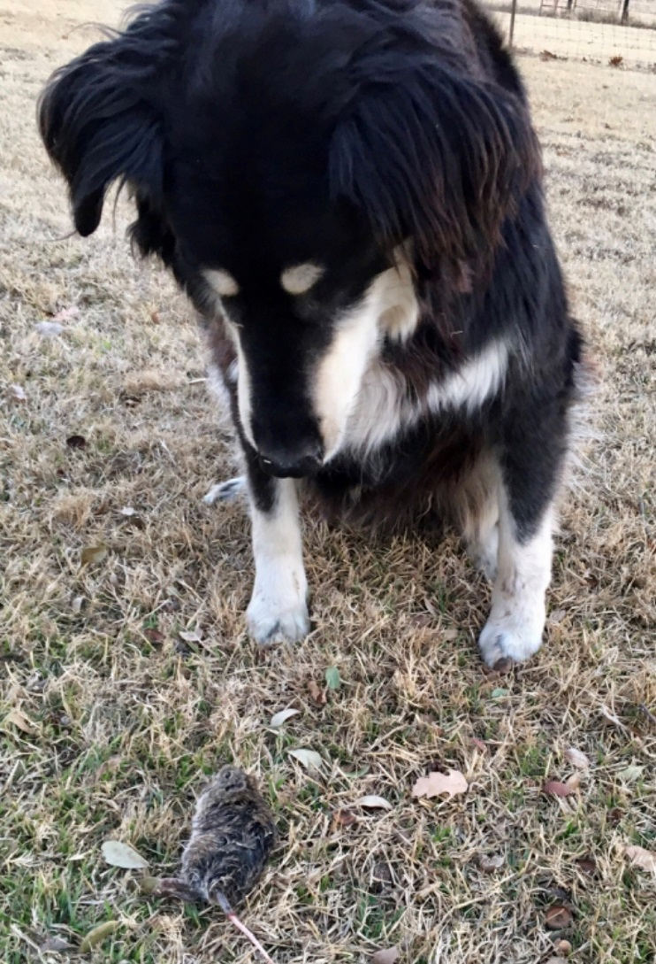

Slide 13
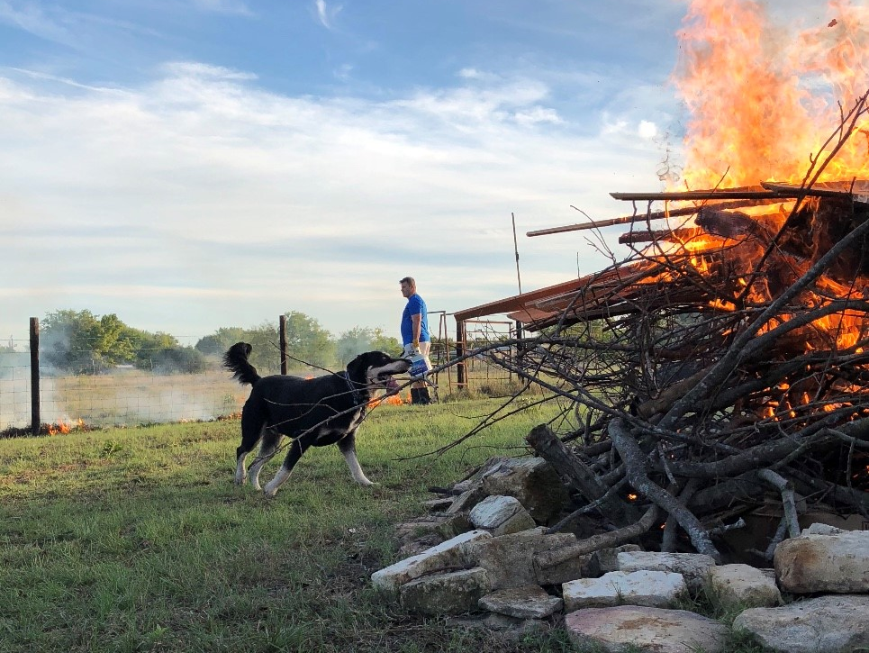

Slide 14
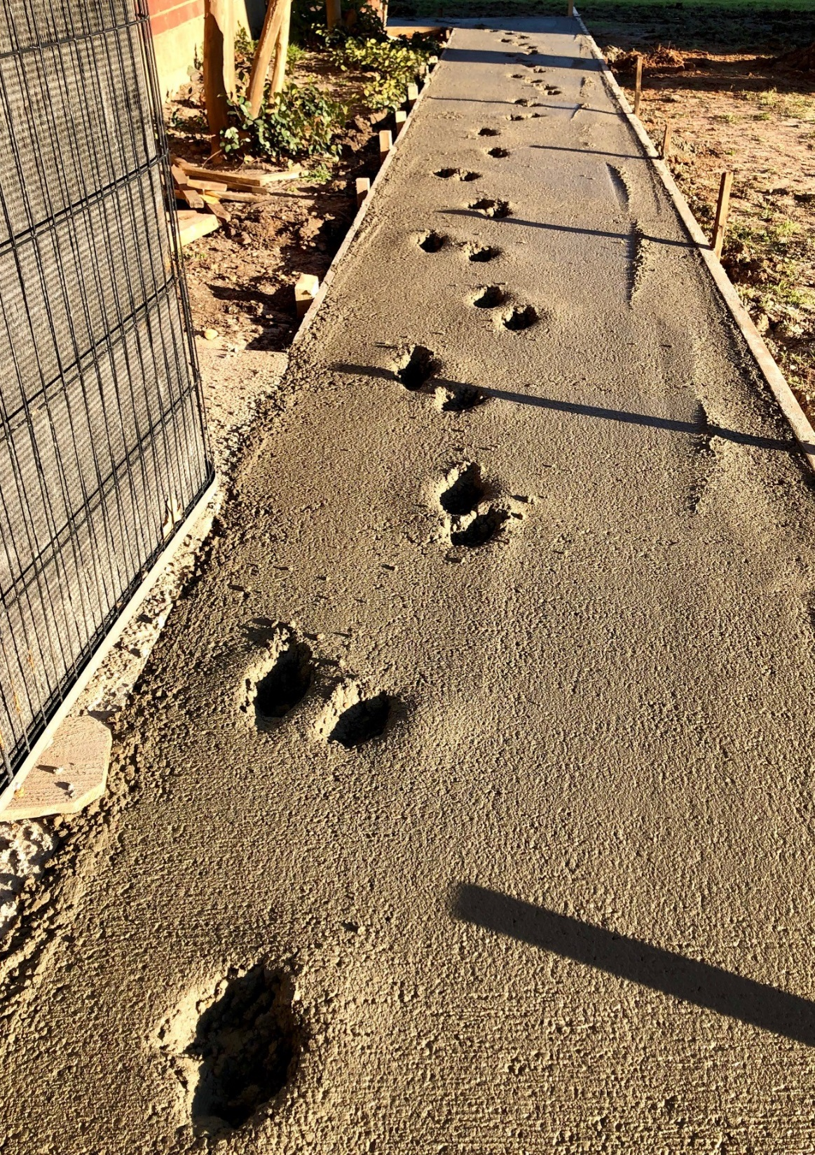

Slide 15
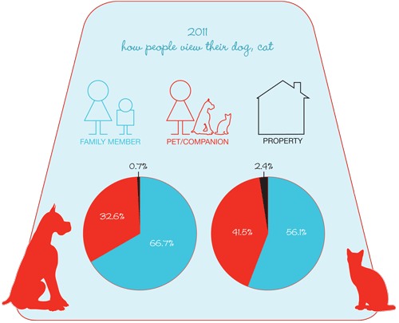
2012 AVMA Pet Ownership and Demographics Sourcebook
Notes:
https://www.avma.org/news/javmanews/pages/130201a.aspx
The new data appear in the 2012 edition of the U.S. Pet Ownership & Demographics Sourcebook, now available from the AVMA. The book draws on a 2012 survey of more than 50,000 households and on data from previous editions.

Slide 16
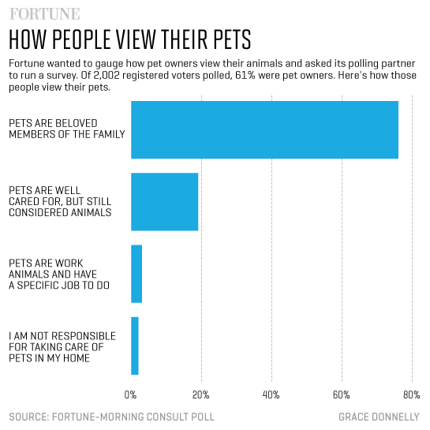
Notes:
http://fortune.com/2016/09/07/pets-are-basically-people/

Slide 17


Las Vegas and Dallas Airports

Slide 18
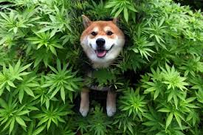
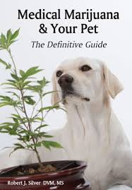
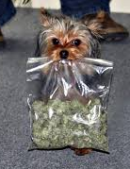
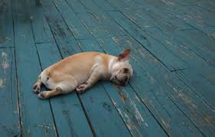

Slide 19
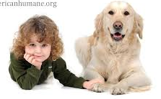
American Humane Association
In most cases, the animal is the last victim in a chain of abuse that filters down from the strongest family member to the weakest.

Slide 20
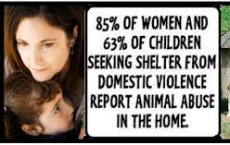
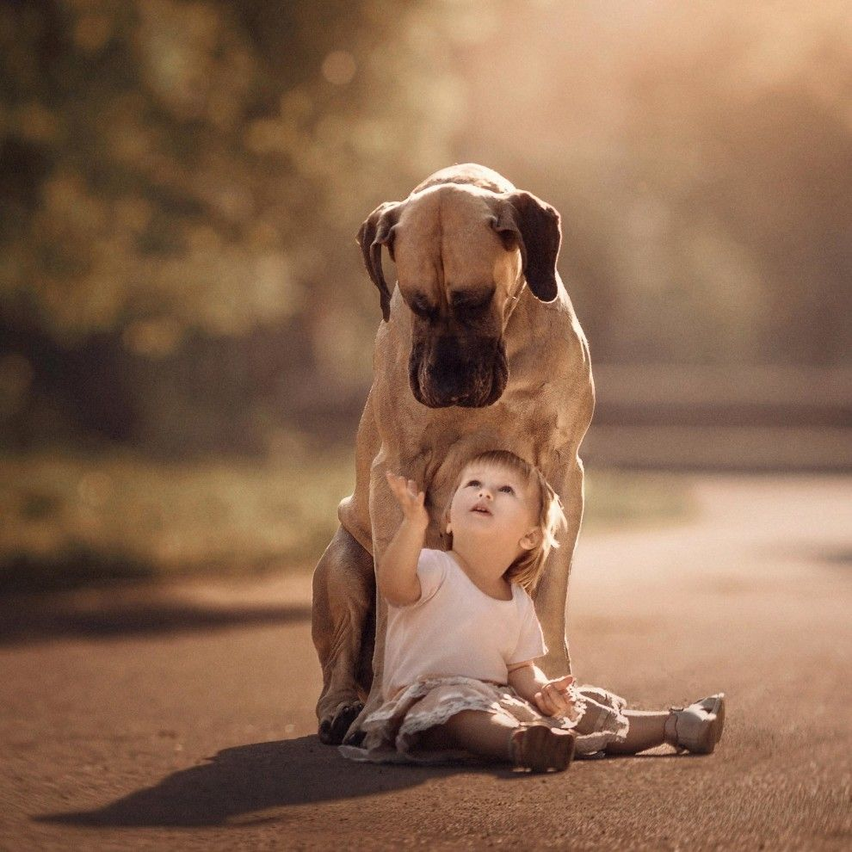
Survey of 50 of the Largest Safe Houses in 49 States & District of Columbia

Slide 21
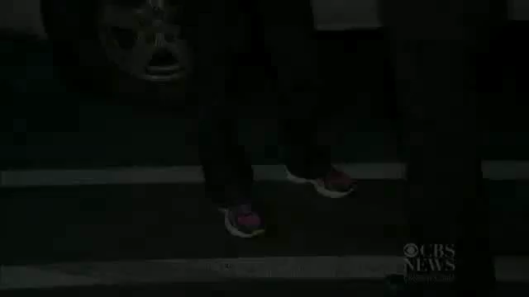

Slide 22
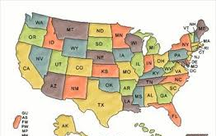
Defining Animal Abuse
All 50 states have legislation relating to animal abuse.
Statues differ from state to state
Legal definitions of animal abuse
Types of animals that are covered
In November of 2019, the PACT Act was signed making Cruelty to Animals a Federal Crime

Slide 23
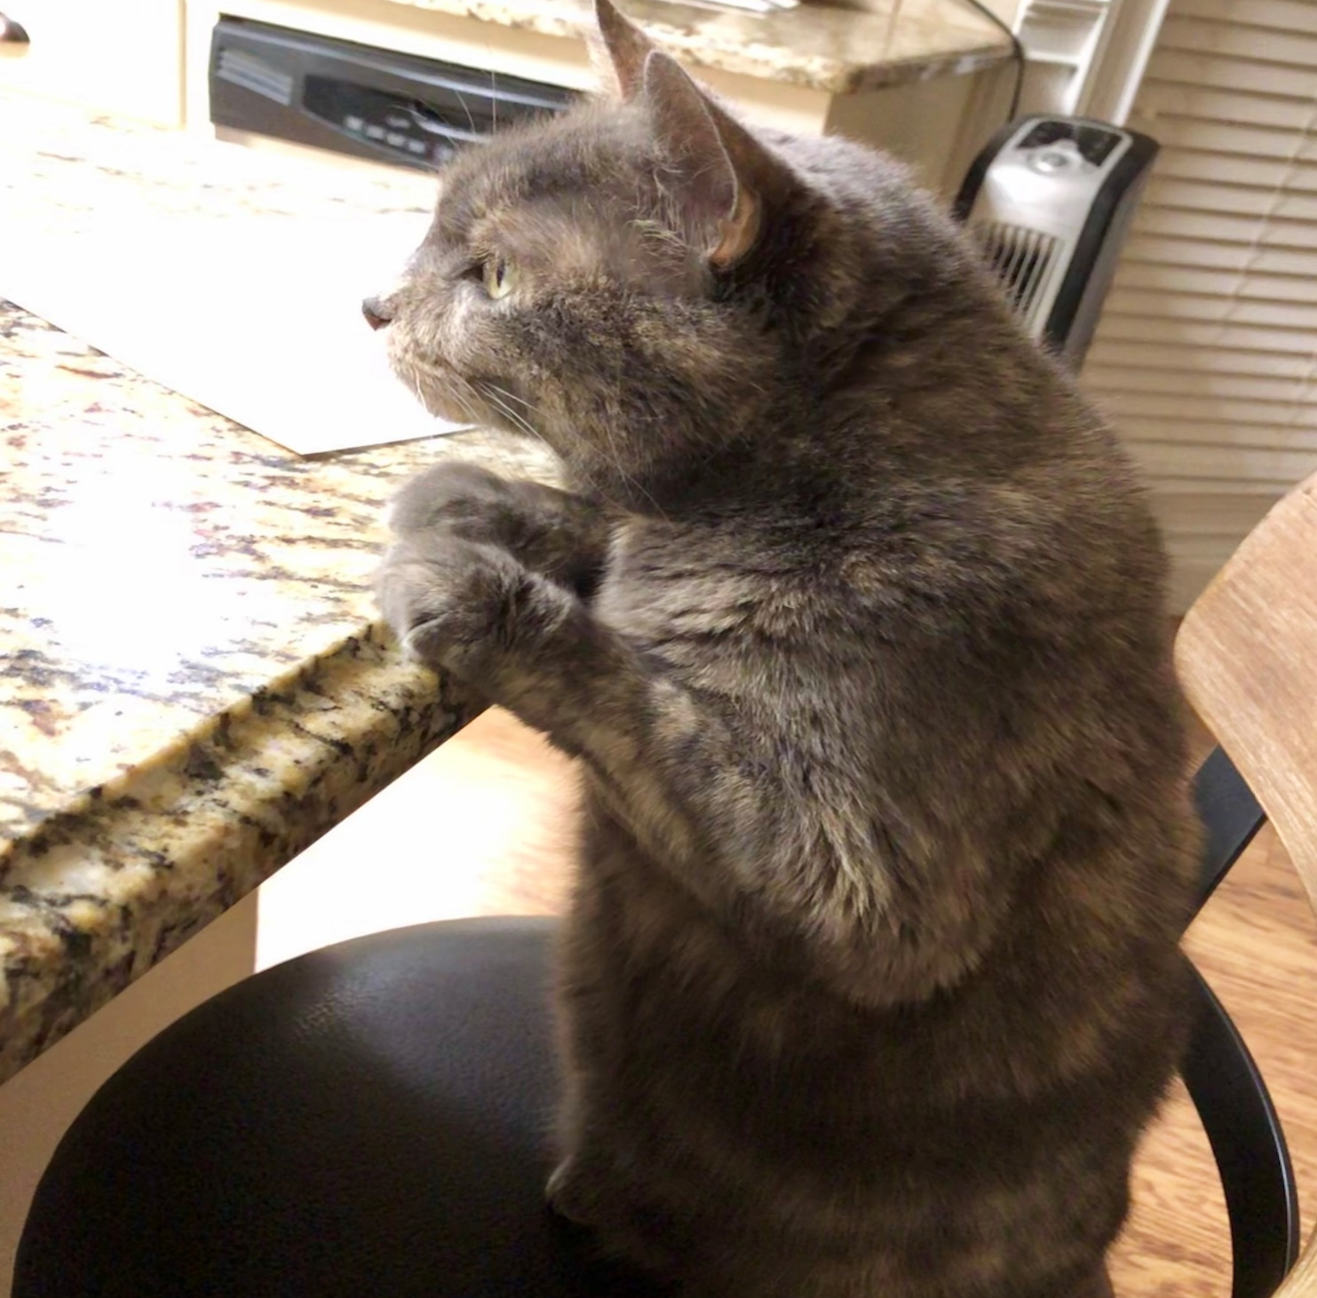

Slide 24
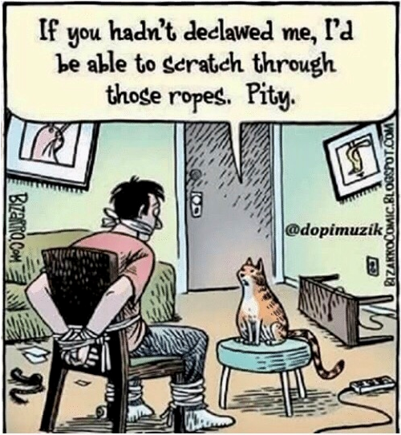

Slide 25

What is the definition of animal abuse?

Slide 26
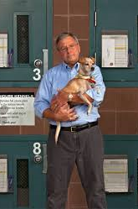
Commonly Accepted Definition
“Socially unacceptable behavior that intentionally causes unnecessary pain, suffering, or distress to and/or death of an animal.”

Slide 27
What are some socially acceptable practices that can harm animals?
Legal hunting
Veterinary practices
Use of animals in testing
(becoming less acceptable)
Certain agriculture practices
The status of a particular animal may vary from one culture to another.

Slide 28

Forms of Animal Abuse May Parallel Forms of Human Abuse
Neglect
Physical abuse
Psychological abuse
Sexual abuse

Slide 29
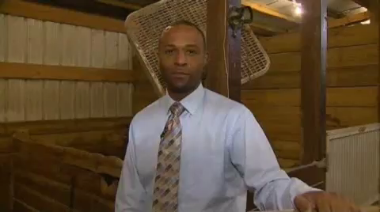

Slide 30
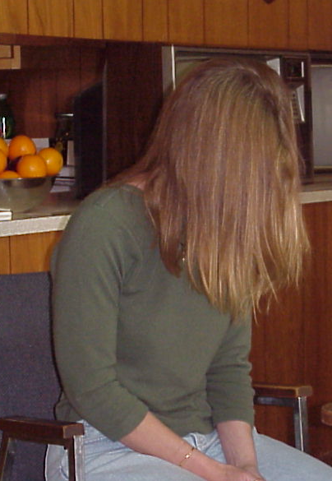
Human & Animal Victims Share Common Denominators
Risk of physical and psychological injury
Unexplained physical trauma
Behavior changes
Failure to thrive, withdrawal and passive behavior

Slide 31
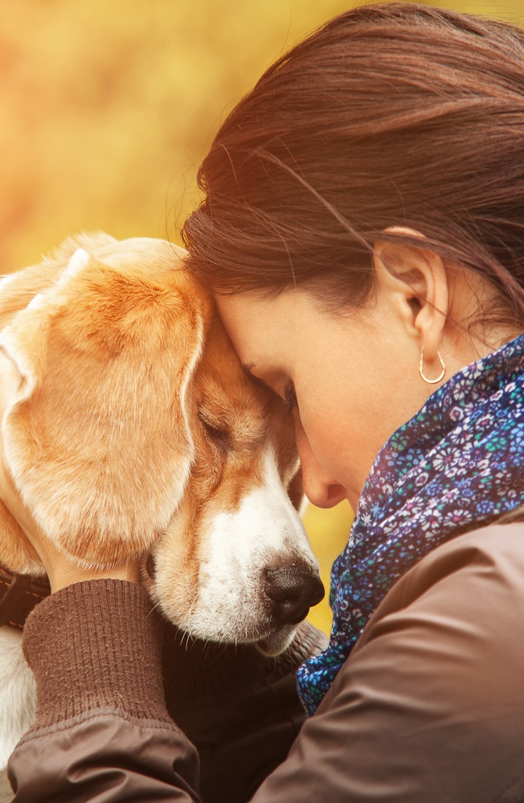
Human & Animal Victims Share Common Denominators
Hostility and lack of trust
Desperation to please anyone showing kindness
Still show love for their abuser
Run away from their abuser

Slide 32
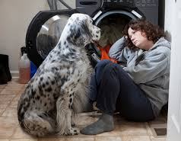
Human & Animal Victims Share Common Denominators
Are living creatures
Have a capacity for experiencing pain and distress
Can display physical signs of their pain and distress
May die as a result of inflicted injuries

Slide 33
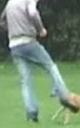
Why are people cruel to animals?
Notes:
Kellert, S.R. & Felthous, A.R., Childhood Cruelty toward animals among Criminals and Noncriminals” Human Relations 38, 1985, P1113-1129

Slide 34
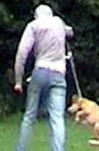
To Control an Animal
Excessive, cruel physical punishment to shape an animal’s behavior or eliminate undesirable characteristics.

Slide 35

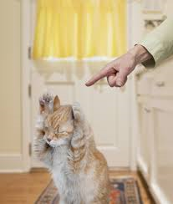
To Retaliate Against an Animal
Extreme punishment and revenge for a presumed wrong on the part of an animal.
Delight taken in retaliatory punishment
Vengeance is intense

Slide 36
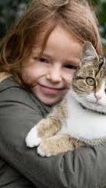
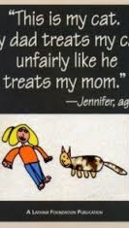
To Retaliate Against Another Person
Striking back or exacting revenge against someone else by killing, mutilating, or torturing their pet.

Slide 37
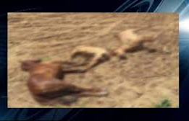
Hillsboro Standoff

Slide 38
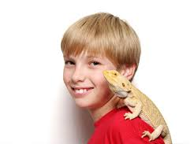
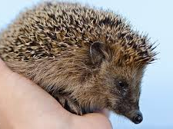
To Satisfy a Prejudice Against a Species or Breed
Culturally-based bias against specific types of animals, such as rats, snakes, or cats.
Violence or sadism is rationalized by a particular prejudice.

Slide 39
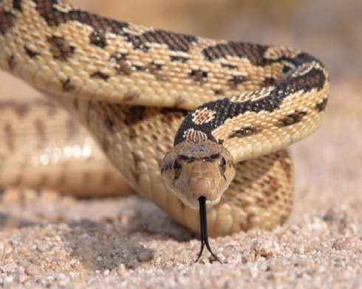
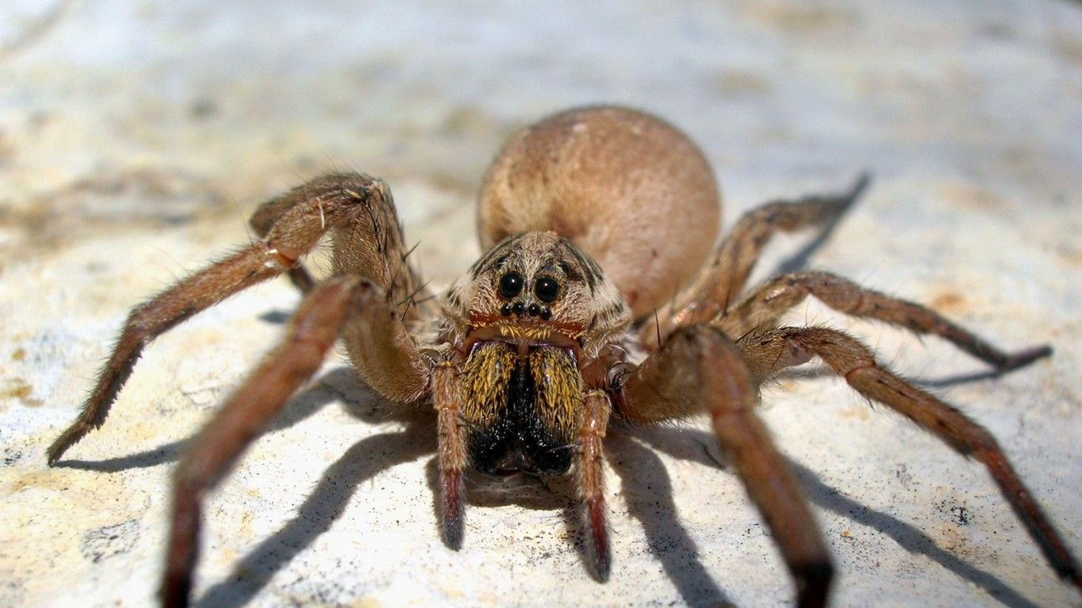

Slide 40
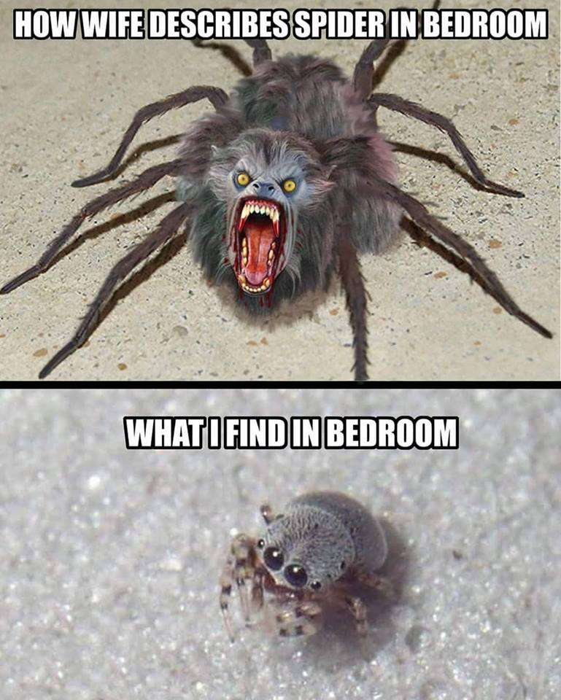

Slide 41
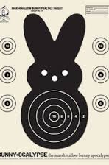
To Enhance One’s Own Aggressiveness
Killing or abusing animals to improve one’s own aggressive skills
Using animals for target practice
To impress others with one’s
capacity for violence.

Slide 42
‘Cat’astrophie
Tamara Barnes knew someone was abusing her cats.
Tom-Tom suffered a broken leg and burned paws.
Miranda had a broken tooth and a swollen eye.
Jeepers’ had a rubber band wrapped so tightly around his neck that it became embedded in the skin.

Slide 43
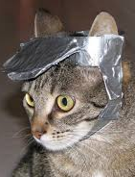
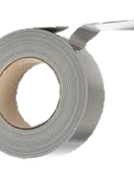
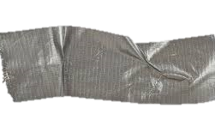
Tamara came home to find her husband wrapping Tom-Tom in duct tape.
Tamara threatened to call the police.
He warned her
“I’ll kill this cat if I want to, and I can kill you, too.”

Slide 44

To Shock People for Amusement
A perverse way of entertaining one’s friends.

Slide 45


To Express Aggression Through an Animal
Cruelty toward animals to express violence or aggression toward other people or animals
Instilling violent behaviors in a dog to make it attack people or other animals

Slide 46

Displacement of Hostility Person to Animal
Displacing feelings of aggression against an unattainable feared or hated authority figure by being violent against that person’s animal.
Attacking a vulnerable animal when assaulting the real human target is judged too risky

Slide 47

Displacement of Hostility Person to Animal
It is often easier in childhood to be violent toward an animal than against a parent, sibling, or adult.

Slide 48

Displacement of Hostility Person to Animal
This is a way for an abused child to get even for his hurt. To retaliate against other people
Hurting their pets
Abusing animals in their presence

Slide 49
Non-specific Sadism
The desire to inflict pain, suffering, or death on an animal without any provocation or hostile feelings.
Cruelty inflicted for the pleasure derived from causing injury and suffering.

Slide 50

Rehearsal for Interpersonal Violence
“Practicing” violence on animals before engaging in violent acts against other people.

Slide 51

Vehicle for Emotional Abuse

Slide 52
The Connections of Various Abuse
Child Abuse & Neglect
Domestic Violence
Animal Abuse

Slide 53

Calvin Markus Roberts of Robinson, TX. Accused of killing Chihuahua puppy before domestic disturbance

Slide 54
Animal Cruelty & Domestic Violence
Roberts' 45-year-old girlfriend called police when she was assaulted by Roberts, who reportedly had killed her dog by throwing it against a wall.
Police said. "That basically led to (her/girlfriend) decision to end their relationship.“
As he packed, Roberts threw the clothing basket at the woman, causing an abrasion and bruising to her leg, Martin said. Roberts then took the woman's cellphone away from her and refused to let her leave the home for about 30 minutes

Slide 55
JUSTICE!!
Police arrested Roberts on a state jail felony charge of animal abuse, a third-degree felony charge of family violence assault and a Class “A” misdemeanor charge of unlawful restraint
Pleaded guilty to assault family violence with a prior conviction and cruelty to non-livestock animals, both third-degree felonies
Roberts has two prior misdemeanor convictions for assault family violence

Slide 56


Slide 57


Slide 58

Questions?

