Slide 1
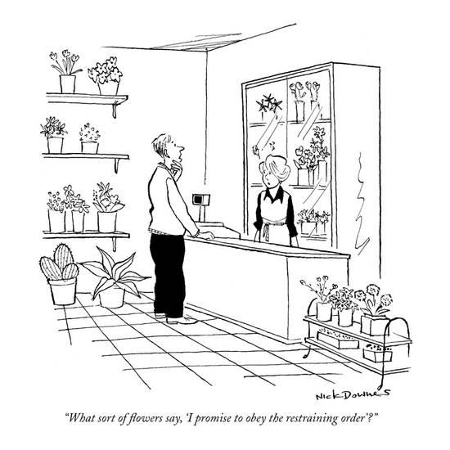
Orders for Protection
What sort of flowers say, “I promise to obey the restraining order?”

Slide 2
Training Objectives
Identify
Identify the types of Protection Orders.
Who
Who can file a Protective Order.
Can it help?
Can Protective Orders reduce violence in domestic abuse situations?

Slide 3
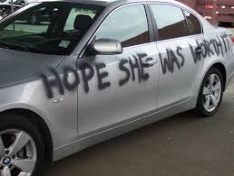
3 Types of Protective Orders in Texas
1. Temporary ex parte protective order;
2. Final (permanent) protective order; and
3. Magistrate's order of emergency protection (what most people call an emergency protective order).
The first two orders are issued by the civil court upon your application. The abuser does not have to be arrested for you to get one of these orders. The third order is issued by the criminal court after the abuser is arrested.

Slide 4
Temporary ex parte protective order
A temporary ex parte order is a court order designed to provide you and your family members with immediate protection from the abuser. You can get a temporary ex parte order without the abuser present in court. To get a temporary ex parte order, the judge has to believe that the abuser presents a clear and present danger of family violence to you or a family member. The judge will make this decision based upon the information you include in your application for a protective order.
A temporary ex parte order lasts for the period of time stated in the order, usually up to 20 days.

Slide 5
Final (permanent) protective order
A permanent protective order is effective for the time period stated in the order, which generally may be up to a maximum of 2 years. If there is no time period written on the order, then it expires on the second anniversary of the date the order was issued.
However, the judge may issue an order for longer than two years under certain circumstances…Felony F.V offense, Serious Bodily Injury, 2 or more previous P.O.’s

Slide 6
Magistrate’s O of E P
Issued by the criminal court after the abuser is arrested for committing family violence, sexual assault, sexual abuse, stalking, or trafficking.
However, if the crime involved family violence that resulted in serious physical injury or if the abuser used (or displayed) a deadly weapon while committing a family violence assault, the magistrate must issue this order even if no one specifically requests it.

Slide 7

“Orders for protection aren’t bullet proof.”

Slide 8

Jenna Scott and her friend, Michael

Slide 9
When Things Go Terribly Wrong
Scott’s attorney tried to tell LePak about additional information on the last day of the hearing, but LePak cut her off because of the length of time the hearing took, according to the transcript.
Scott applied for a protective order against Marks, a former mixed martial arts fighter.
Marks told her he’d gotten away with murder before and “he could do the same in Texas.” Marks also threatened her and her family and told her he had friends in the Killeen Police Department.
Judge denied her request for a two-year order. LePak didn’t know about the felony burglary charge against Marks when he denied the protective order, records showed.

Slide 10
In comments made to Marks by LePak after he rendered his ruling, LePak said he wasn’t certain about denying Scott’s protective order. He cautioned Marks about his uncertainty before he denied the protective order.
A complaint against LePak was filed with the Texas Commission of Judicial Conduct by Jonathan Scott, Jenna Scott’s father.

Slide 11


Slide 12

Cedric Marks

Slide 13
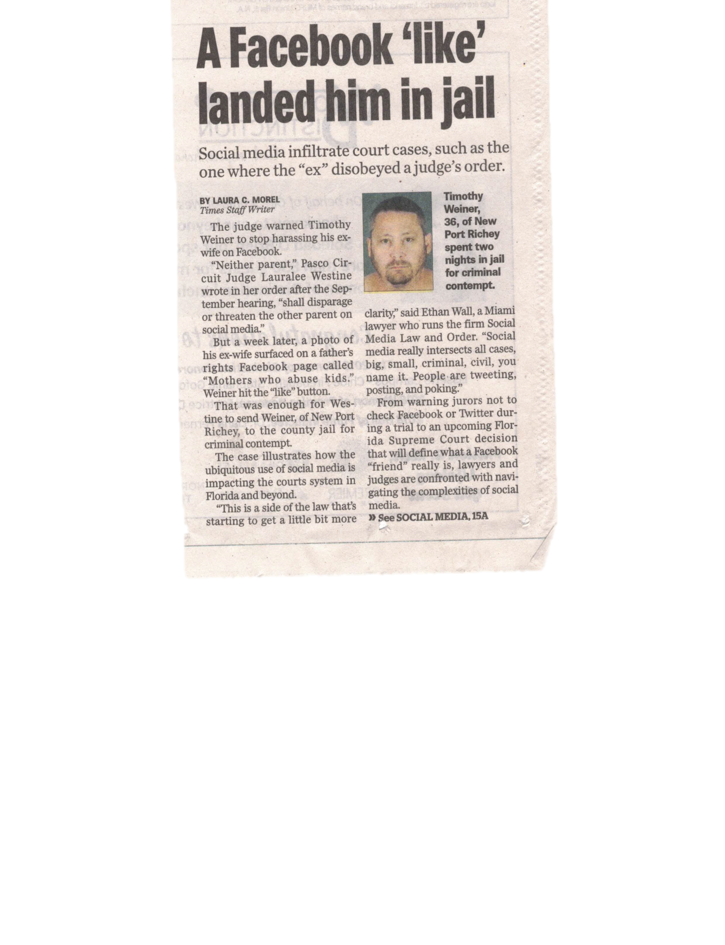
No harassing petitioner on social media
“Neither parent ,”Pasco Circuit Judge Laurealee Westine wrote in her order after the September hearing, “shall disparage or threaten the other parent on social media.”
Timothy Wiener ex-wife’s photo surfaced on a father’s rights Face book Page called “Mothers who abuse kids.”

Slide 14
No harassing petitioner on social media
Under oath in the courtroom, Weiner admitted to liking the post bout his ex-wife.
The judge sent him to jail for 60 days.
Weiner’s lawyer convinced the judge he had learned his lesson and was released after two days.

Slide 15
No harassing petitioner on social media
“I absolutely did not expect to got to jail,” Weiner told the Tampa Bay Times. “My freedom of speech was violated even though I didn’t say anything. All I did was like a Facebook post.”

Slide 16
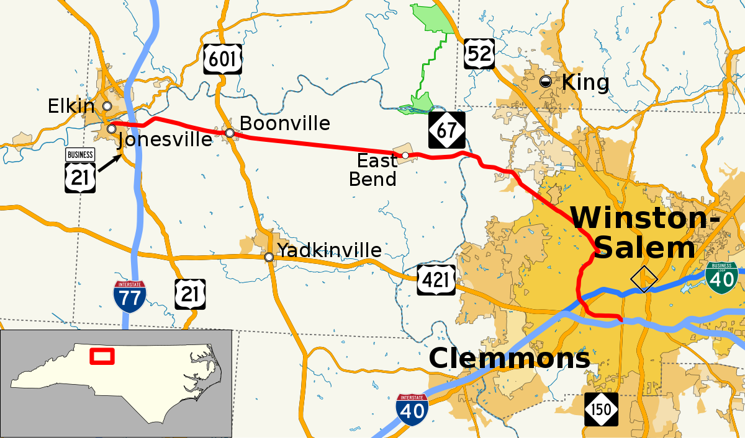
Jonesville, NC Area: 1.9 square miles Population: 2,285 (2010)

Slide 17

Notes:
Tuesday, June 30, 2009, a settlement was reached just a day after the case was about to go to trial. A jury pool had been called on Monday and at the close of the day, lawyers from both sides met to discuss jury selection but wound up coming to a settlement instead. When court reconvened the next morning, the judge announced the case had been settled and Vernetta was awarded a sum of $430,000. Read more: http://www.oprah.com/relationships/domestic-violence-vernetta-cockerham-trial-update/all#ixzz56WsuLofT

Slide 18
The following may apply for a Protective Order:
Adult member of family
Prosecuting attorney
Department of protective and regulatory services CPS/APS
Victim of Family Violence
Victims of Sexual Assault

Slide 19
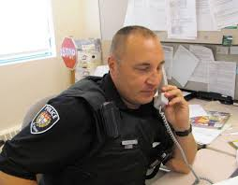
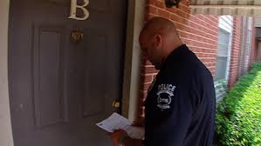
When does a Protective Order become effective?
At the time of personal service
When the respondent is given notice of the existence and terms of the order by a peace officer or the court, whichever is earlier.

Slide 20
Now what?
After notice of the existence of the order a peace officer or the court may:
Enforce the terms of the order
Act immediately upon any violation of the order
After notice of the order, all reasonable efforts shall be made for personal service of the order upon the respondent.

Slide 21
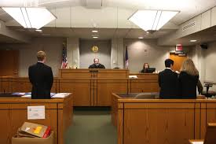
How long?
Depends on the type of abuse (stalking, dating violence, sexual assault, family violence); the seriousness of the harm, if children were present, if an arrest was made, past violence, the likelihood of future violence, and other factors. PO’s for family violence usually last two years, but can be for any duration, including for life. Sexual assault PO’s usually last for life.

Slide 22

What are the constraints that may be placed on the respondent?
Restraining the adverse party from:
Not to hurt, threaten, or harass you or your children, either directly or through another person
Stay away from you, your family, your home, workplace, and children’s day care or school
Not to carry a gun, even with a license.

Slide 23
What are the constraints that may be placed on the respondent?
Directing the adverse party to vacate the residence (Kick-Out Order) shared by the parties to the action
Grant temporary custody
Enter other orders the court believes will be of assistance in eliminating future acts of domestic violence and abuse; or any combination thereof.

Slide 24
What should officers check on the order of protection?
Name of petitioner
Name of respondent
Beginning date of the order
Ending date of the order
Conditions placed by the court on the respondent
Signed by a judge

Slide 25
READ THE ORDER
Order may state something in one paragraph and specify exceptions in another.
EX: NO CONTACT
Then, allow for contact to arrange child visitation

Slide 26
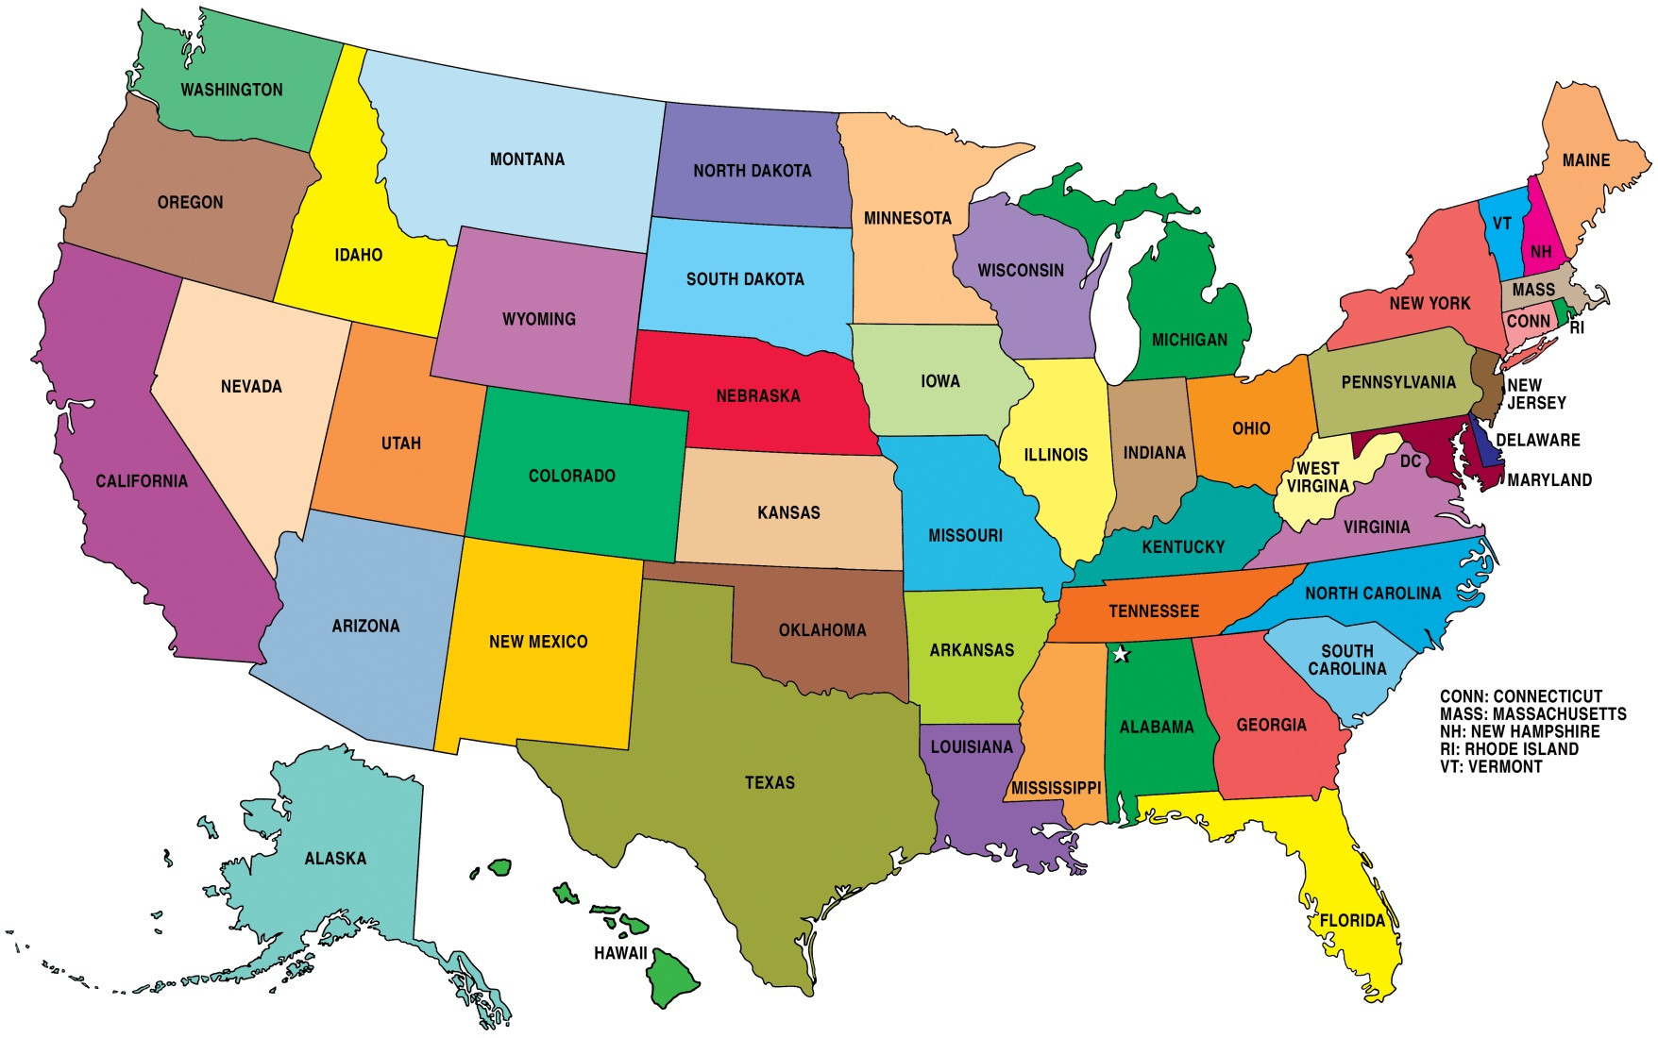
Warrantless Arrest Exceptions

Slide 27
Which jurisdiction’s laws apply?
ISSUING JURISDICTION DETERMINES:
Who is protected
Terms and conditions of the order
How long the order is in effect

Slide 28
Which jurisdiction’s laws apply?
ENFORCING JURISDICATION DETERMINES:
How the order is enforced. Is the violation a crime?
Arrest authority of responding law enforcement
Detention/notification procedures
Penalties/sanctions for violations

Slide 29


Why get an order of protection?
They provide coercive control over the respondent.

Slide 30
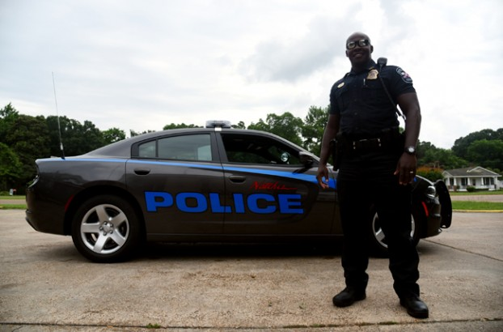
Why get an order of protection?
Orders empower law enforcement officers and the court to act on behalf of the victim when they couldn’t otherwise do so.

Slide 31
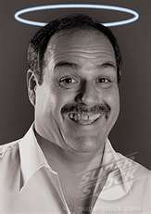
It is meant to constrain the abuser’s bad behavior.

Slide 32


Orders govern what behavior the abuser is allowed to do and not to do.
When they step outside those confines, law enforcement and the courts act to correct the behavior.

Slide 33
Orders for protection do protect if:
Victims call every time there is a violation.
Law enforcement officers aggressively enforce them.
The courts punish the violator appropriately every time.

Slide 34
A second violation of an order should be considered a serious risk factor for the victim.
Attempts should be made to have the judge consider “no bond” until trial.

Slide 35

What if the petitioner invites the respondent over and then calls the police while he is there?

Slide 36
Relationship and your duty
Issuance of a Protection Order constitutes a “special relationship” between the petitioner and law enforcement.
This creates a “special duty” for law enforcement to properly enforce the Order.

Slide 37
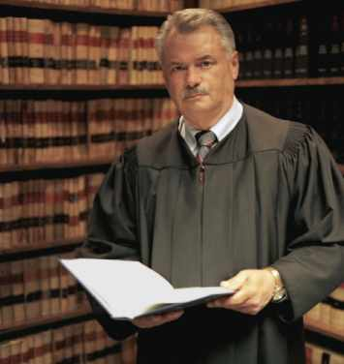
This is an Order from a judge instructing law enforcement to take action in certain situations.
Enforce 100% of the time.

Slide 38

If the petitioner gets hurt, you could be charged with failure to protect due to gender bias. That is a federal civil rights violation.
If you do fail to act, the judge could issue an order to show cause to hold you in contempt of court.

Slide 39

A “ Zero Tolerance” approach to violations is best.
Enhances safety for the victim

Slide 40

Monitoring

Slide 41
Do orders of protection reduce violence in abusive relationships?

Slide 42
Houston Study
Objectives
We compared types and frequencies of intimate partner violence experienced by women before and after receipt of a 2-year protection order.

Slide 43
Houston Study
Methods
Participants were 150 urban English- and Spanish-speaking Black, Hispanic, and White women who qualified for a 2-year protection order against an intimate partner.

Slide 44
Houston Study
Results
One woman committed suicide 6 weeks into the study.
The remaining 149 women completed all interviews.
Results showed significant reductions in threats of assault, physical assault, stalking, and worksite harassment over time among all women.

Slide 45
Houston Study
Conclusions
Abused women who apply and qualify for a 2-year protection order, irrespective of whether or not they are granted the order, report significantly lower levels of violence during the subsequent 18 months.
American Journal of Public Health. 2004;94:613–618

Slide 46
Kentucky Study
106 rural and 107 urban women who received a protection order was interviewed at 3-months, and 6-months.
50% of the protective order had been violated
50% of the protective order had not been violated

Slide 47
Kentucky Study
Even for those who experienced protective order violations, the abuse was significantly reduced over time.
The Kentucky Civil Protective Order Study

Slide 48
Which offenders are most likely to violate an order of protection?
Respondents who stalk
Stalking the six months prior to obtaining the protective order was significantly associated with protective order violations.

Slide 49

Mary Matthews Vs. Pickett County, et al.
Tennessee Supreme Court, June 1999

Slide 50

Facts Presented to the Court
Ms. Matthews was assaulted, beaten, and sexually violated by her estranged husband, Bill Winningham
Matthews received an Order of Protection against Winningham

Slide 51
Facts Presented to the Court
The order prohibited Winningham “from coming about the petitioner for any purpose and specifically from abusing, threatening to abuse the petitioner, or committing any acts of violence upon the petitioner.”
The order further provided that Winningham “shall be arrested by a law enforcement officer without a warrant if that officer has reasonable cause to believe that [Winningham] has violated or is violating this Order.”

Slide 52



Facts Presented to the Court
Nov 18, 1993, the eve of the hearing on their pending divorce, Winningham
Threatened to kill Ms. Matthews
Attempted to break into her home
Ms. Matthews telephoned the sheriff’s department at approximately
9:30 p.m.
10:00 p.m.
10:30 p.m.

Slide 53

Facts Presented to the Court
Winningham set firecrackers under Ms. Matthews propane tank.
Winningham had severed the petitioner’s telephone line.
Two deputies arrived at Ms. Matthews house at approximately 11:50 p.m.
They spoke to Winningham but did not arrest him.

Slide 54
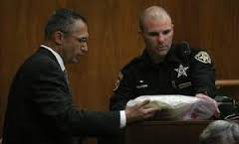
Facts Presented to the Court
One deputy testified that he did not believe he could have arrested Winningham without a warrant.
The other deputy testified that there was no probable cause for an arrest because no act of violence was committed in the deputies’ presence.

Slide 55


Facts Presented to the Court
Deputies took Ms. Matthews to the courthouse so she could swear out a warrant for Winningham’s arrest.
Deputies were informed that a warrant was not necessary so they returned Ms. Matthews to her residence.

Slide 56

Facts Presented to the Court
When they arrived they discovered that her automobile had been riddled with bullet holes while they were at the courthouse.

Slide 57
Facts Presented to the Court
One of the deputies’ cousin stayed at the residence while she was escorted out of the county.
The cousin testified that he had observed Winningham return to petitioner’s house with a large container and leave a few minutes later without the container.
When the deputies returned to pick up the cousin they observed Winningham leaving Ms. Matthews’ home.
57

Slide 58

Facts Presented to the Court
Winningham was not stopped and questioned.
The deputies did not examine the house at close range.
They shined a spotlight on the home from the road but did not notice anything unusual.

Slide 59
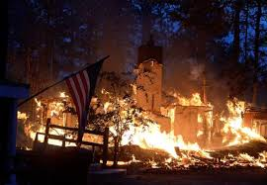
Facts Presented to the Court
Ms. Matthews’ house burned to the ground after the deputies left.

Slide 60

Ruling of the Court
“Despite an abundance of probable cause to arrest Mr. Winningham for violating the order of protection, the deputies failed to arrest [him]”
The order of protection established a special relationship between Ms. Matthews and law enforcement officers.

Slide 61
Ruling of the Court
The special duty exception to the public duty doctrine is applicable to this case
The deputies breached the duty owed to Ms. Matthews; she may recover damages proximately caused by that breach.

Slide 62

Ruling of the Court
Ms. Matthews was awarded
$300,000 from Pickett County
$130,000 from the deputies

Slide 63
How can I help?

